Slide 1


Predicting which Tweets are about real disasters
Course Name: SCS 3253-022 Machine Learning
Instructor: Pashootan Vaezipoor
Apr 23rd 2020
By:
Vaishali Bhat
Olga Senko

Slide 2






Sample 2
Project check-list
Solution
6
Get the data
1
Prepare the data
3
Frame the problem
5
2
Explore models
Explore the data
4

Slide 3

Frame the problem
In the future … every significant … decision will have Twitter input
Chris Moody, VP of Data Strategy at Twitter
650MM tweets per day
280 characters
Business Implication
Personal implication
Global Implication
THEY
ME
WE
In times of a crisis situation, affected people post useful information on Twitter that can be used for situational awareness and other humanitarian disaster response efforts, if processed properly and rapidly. Access to this information provides affected businesses possibility to make informed decisions. The main challenge is in locating the right information. In addition to posting valuable info during emergency, many people also use the same words to deliver general not urgent ideas
Frame the problem
Get the data
Explore the data
Conclusion
Prepare the data
Explore models

Slide 4
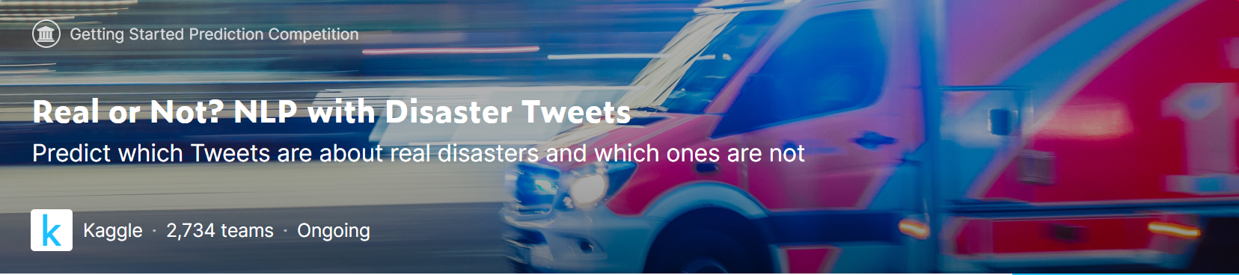
Get the data
Data Source
Data set
Columns
Kaggle
Link
10,000 tweets
hand classified
5 variables
id, text, location, keyword, target (label)
whether a given tweet is about a real disaster or not.
If so, predict a 1. If not, predict a 0.
TARGET OUTCOME
Frame the problem
Get the data
Explore the data
Conclusion
Prepare the data
Explore models

Slide 5
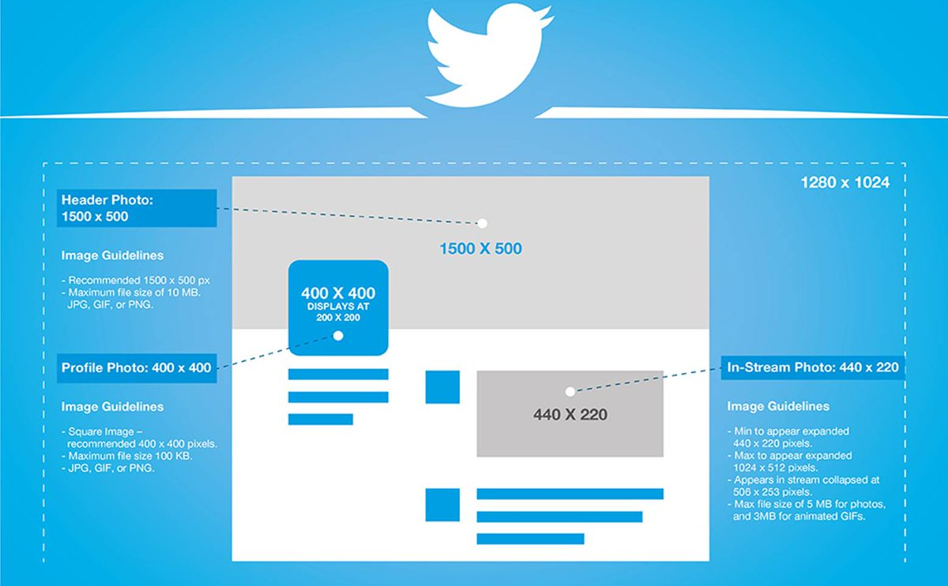

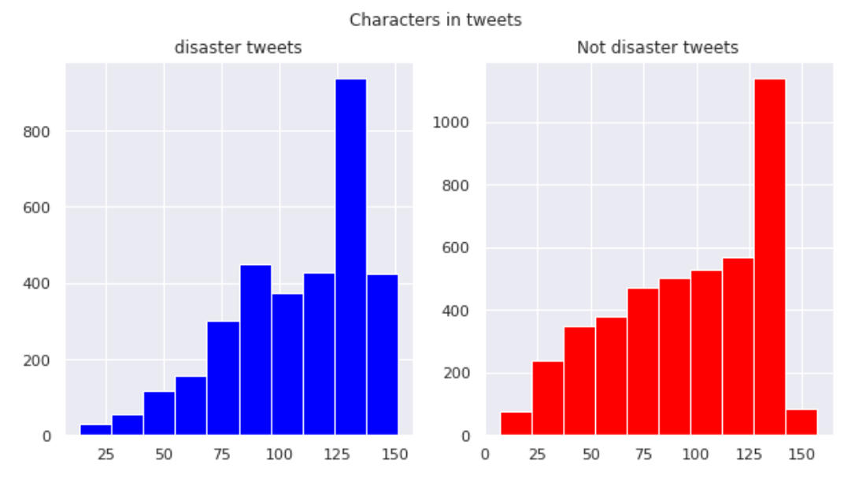
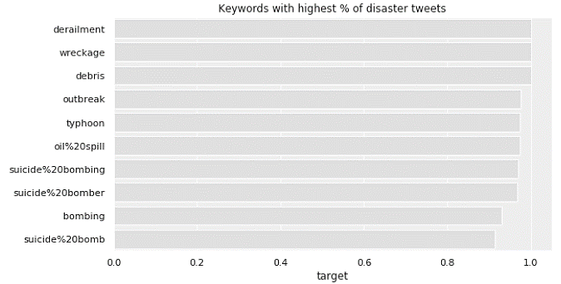
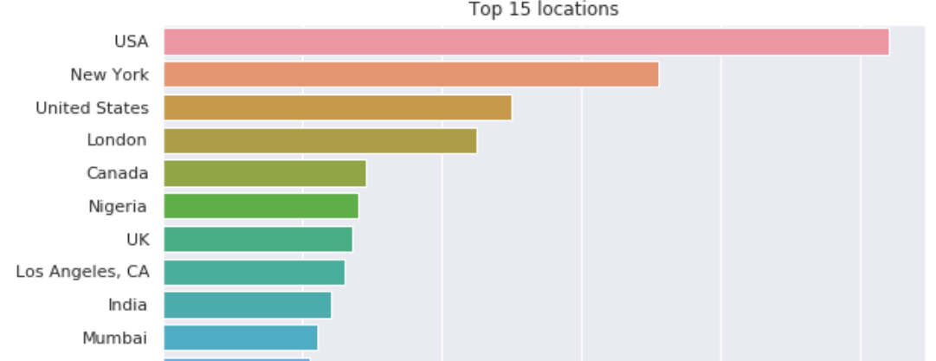
Explore the data
5 columns
7613 rows
Feature Engineering required – next slide
Training data set
DISASTER or NOT
Target outcome
Keywords with highest % of disaster tweets
Characters in tweets
Top 15 locations
disaster
Not disaster
Frame the problem
Get the data
Explore the data
Conclusion
Prepare the data
Explore models

Slide 6

Prepare the data
Unigrams & bigrams
Feature Engineering
word_count - number of words in text
unique_word_count - number of unique words in text
stop_word_count - number of stop words in text
url_count - number of urls in text
mean_word_length - average character count in words
char_count - number of characters in text
punctuation_count - number of punctuations in text
hashtag_count - number of hashtags (#) in text
mention_count - number of mentions (@) in text
Frame the problem
Get the data
Explore the data
Conclusion
Prepare the data
Explore models

Slide 7

Explore models
Submissions are evaluated using F1-SCORE
between the predicted and expected answers
Ensemble of models
BERT by Google with label correction
BERT by Google without label correction
XGBoost
Neural Network
We are at 80th percentile rank:
on 403 place out of 2,671 team
Frame the problem
Get the data
Explore the data
Conclusion
Prepare the data
Explore models

Slide 8

Conclusion
We have shown different Data Cleaning tasks related to text such as removing urls, non ascii characters, replacing abbreviations.
We trained both classical machine learning models such as XGBoost and Deep Learning based models with pre-trained word embeddings from GloVe.
We also explored "BERT" a State of the art language model published by researchers at Google AI Language that outperformed all other models and pushed our Kaggle Leaderboard score to 0.84 whereas the highest score using classical ML approach was 0.43.
Frame the problem
Get the data
Explore the data
Conclusion
Prepare the data
Explore models

Slide 9

appendix

Slide 10
Explore models
SUMMARY
MODEL | FEATURE ENGINEERING | INPUT EMBEDDING | HYPERPARAMETERS | LEADERBOARD SCORE
BERT by Google AI language | Abbreviations such as ppl, nyc, etc were replaced. None of targets (labels) corrected | BERT pre-trained word embeddings | Maximum character sequence considered=160 | 0.8404
BERT by Google AI language | Removed Emoji, URLs and non-ASCII characters, punctuations 16 Targets that were misclassified were corrected | BERT Pre-trained word embeddings | Maximum character sequence considered=128 | 0.8353
ENSEMBLE OF FOLLOWING MODELS BERT pretrained word embeddings fed to a Dense Layer Pretrained smaller dimensional word embeddings by Universal Sentence Encoder fed to SVM Pretrained higher dimensional word embeddings by Universal Sentence Encoder fed to a MLP Pretrained higher dimensional word embeddings by Universal Sentence Encoder fed to SVM | Removed hashtags, usernames, links Converted text to lowercase Added features: number of hashtags, usernames, links, mentions | BERT pre-trained word embeddings Universla Sentence encoder pre-trained word embeddings | Maximum character sequence considered=512 SVM: kernel='rbf’, gamma='auto' MLP: Dense and Sigmoid with two Conv1D & MaxPool layers, Number of epochs = 5, batch_size=16, Learning Rate=2e-6 | 0.8312
NEURAL NETWORK WITH: Embedding Layer BiLSTM Layer GlobalMaxPooling1D BatchNormalization Drop out of 0.5 Dense Layer with RELU activation Drop out of 0.5 Dense with with RELU activation Dropout of 0.5 Dense with sigmoid activation | None | GloVe, Pre-trained word vectors from Twitter | 27B tokens of 200 Dimensional vectors, batch_size=32, epochs=15, default Learning rate | 0.7678
XGB Classifier with Randomized Grid Search | Removed URLs, HTML Tags, emoji, punctuations, non alphabet characters. Converted text to lowercase | Word2Vec from Gensim library and TfidfVectorizer | ‘subsample': 0.99; 'n_estimators': 200; 'min_child_weight': 16; 'max_depth’: 7; 'learning_rate': 0.1; 'gamma': 0.05; 'alpha': 7 | 0.4314

Slide 11
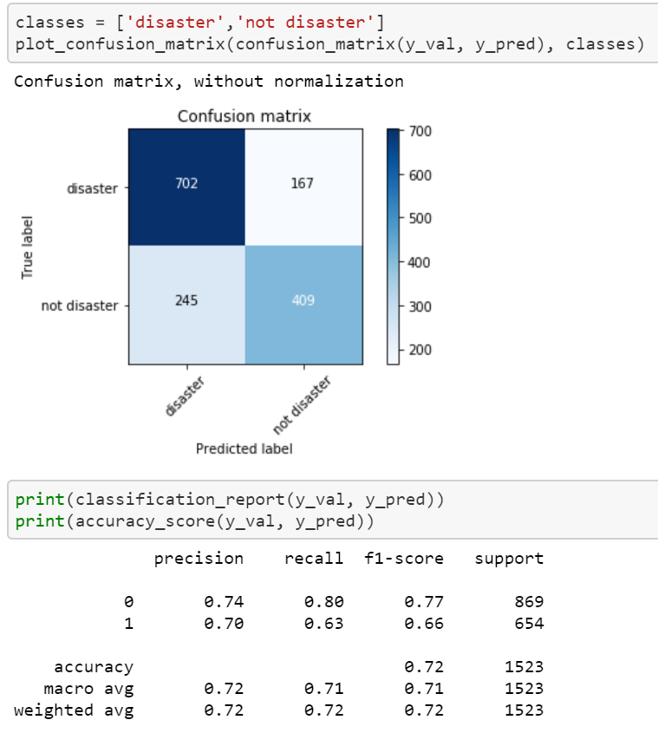
XGBoost
Word embedding transformation from words to vectors by computing TD-IDF
Term frequency – inverse document frequency
Term Frequency: This summarizes how often a given word appears within a document
Inverse Document Frequency: This downscales words that appear a lot across documents

Slide 12
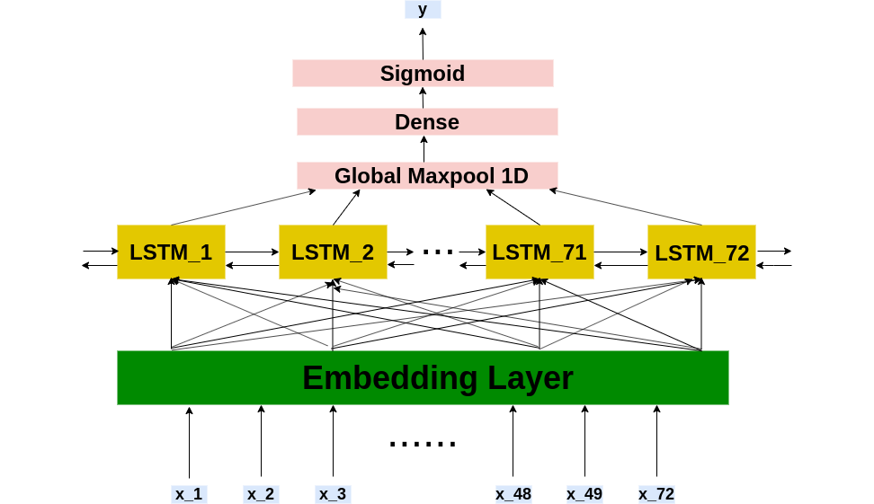
Neural Network with:
Train Bidirectional LSTM Model with pre-trained GloVe word embeddings. We built 5 networks and train it using GloVe features as the inputs. The architecture of all the networks is same and below is it's pictorial representation.
Embedding Layer
BiLSTM Layer
GlobalMaxPooling1D
BatchNormalization
Drop out of 0.5
Dense Layer with RELU activation
Drop out of 0.5
Dense with with RELU activation
Dropout of 0.5
Dense with sigmoid activation

Slide 13
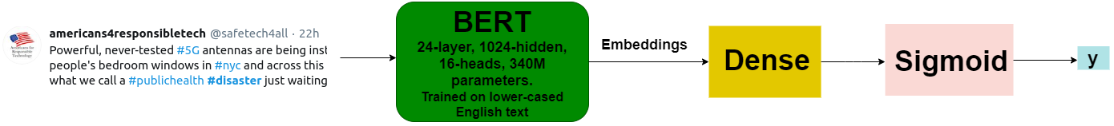
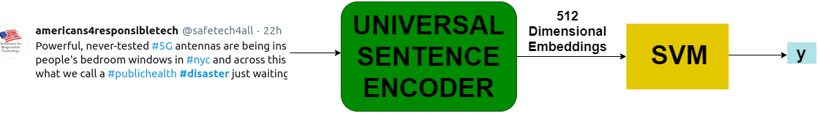
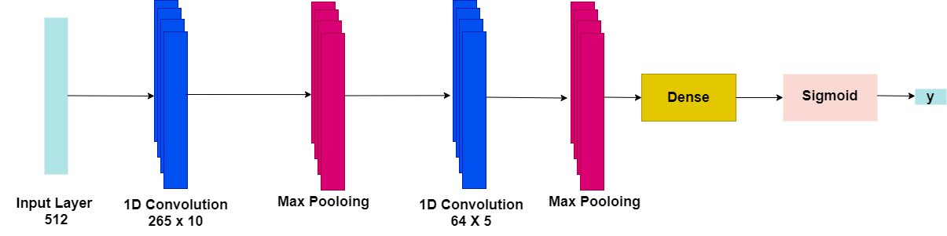
ENSEMBLE OF FOLLOWING MODELS
BERT pretrained word embeddings fed to a Dense Layer
Pretrained smaller dimensional word embeddings by Universal Sentence Encoder fed to SVM
Pretrained hisher dimensional word embeddings by Universal Sentence Encoder fed to a MultiLayerPerceptron
Pretrained higher dimensional word embeddings by Universal Sentence Encoder fed to SVM

Slide 14
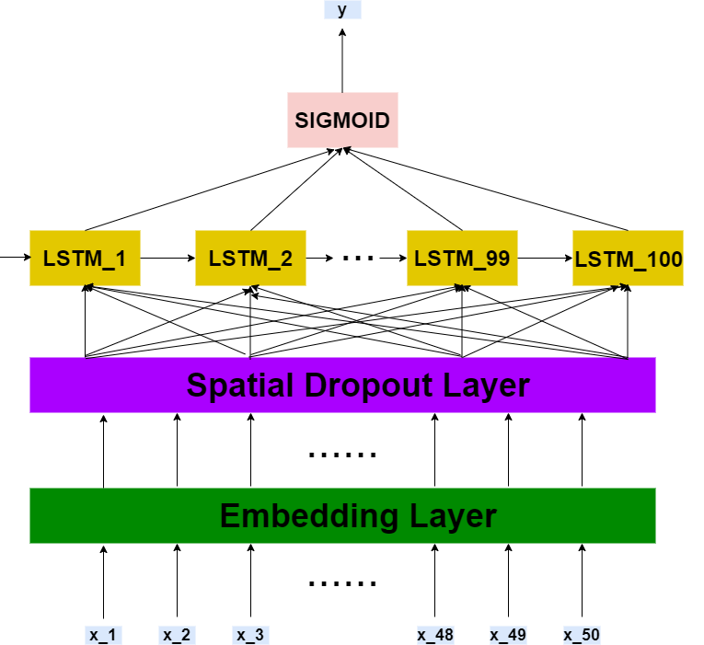
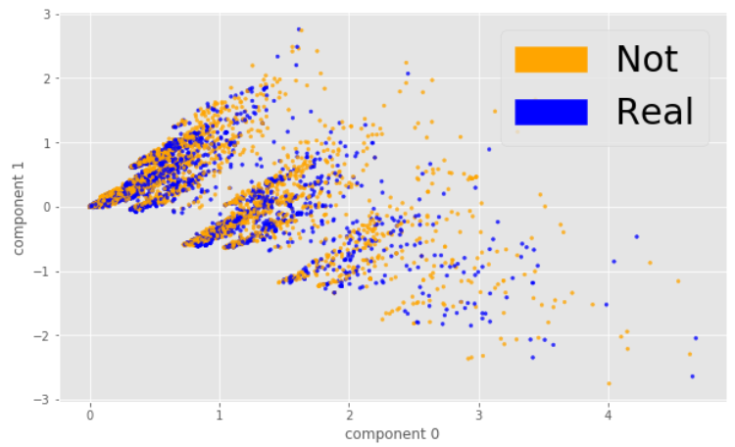
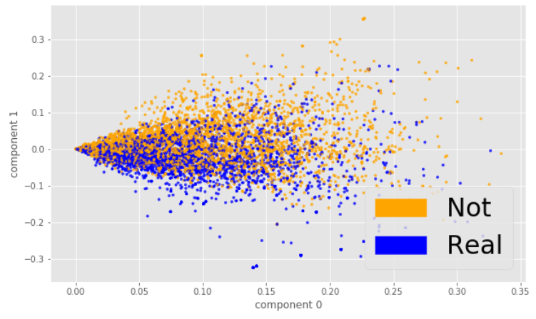
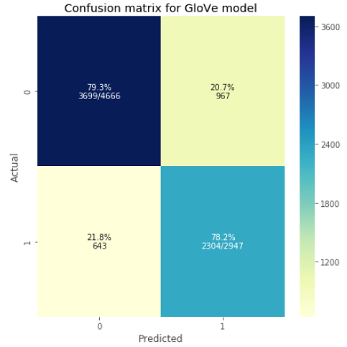
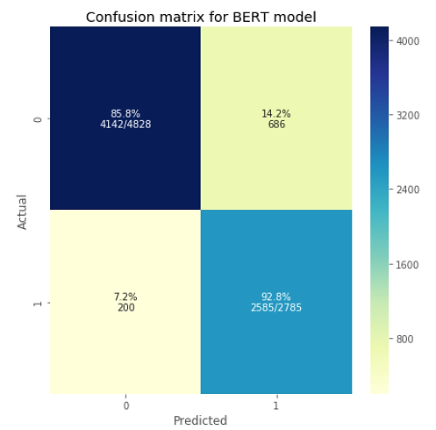
BERT by Google AI language
# Showing Confusion Matrix for GloVe model
# Showing Confusion Matrix for BERT model
Word Embeddings using Bag of Words
Word Embeddings using TF IDF
Word Embeddings using GloVe
Showing Confusion Matrices on the validation set for the 2 trained models.

